Slide 1

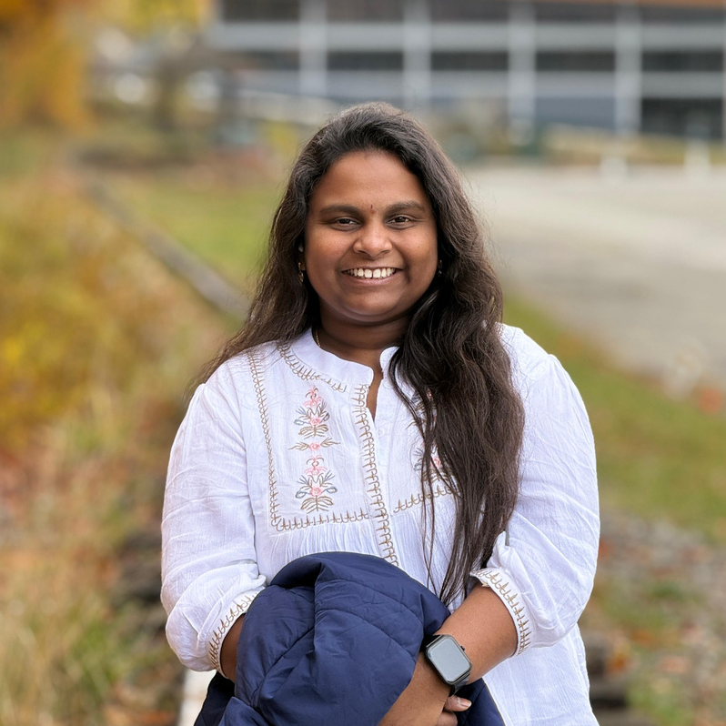
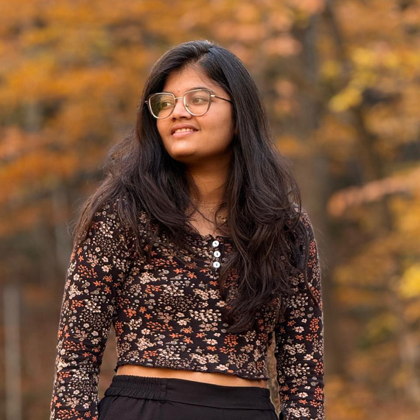
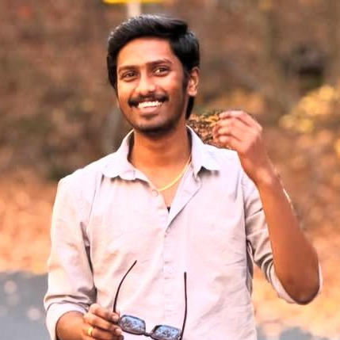
MEET OUR TEAM
DHARANI RAVANAM
TEJA ASRITHA GOLI
KARTHIK BOMMARTHI
08

Slide 2


GREEN TO
CONCRETE
RATIO
01

Slide 3
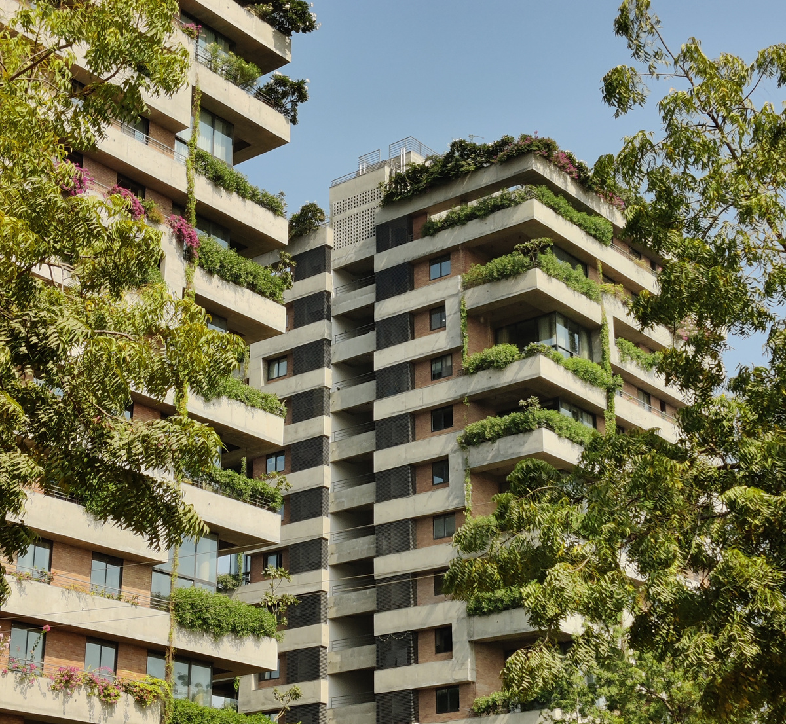
OBJECTIVE
Our Objective aims to use AI Image Processing to analyze satellite or drone images and determine the green-to concrete ratio in urban areas. We will identify and classify areas of vegetation and concrete, calculate their ratio for urban planning, and develop a method that can be easily applied to assess green spaces in cities
02

Slide 4

PROPOSED MODEL
To Implemment a CNN,Specifically Using a UNet architecture
03

Slide 5
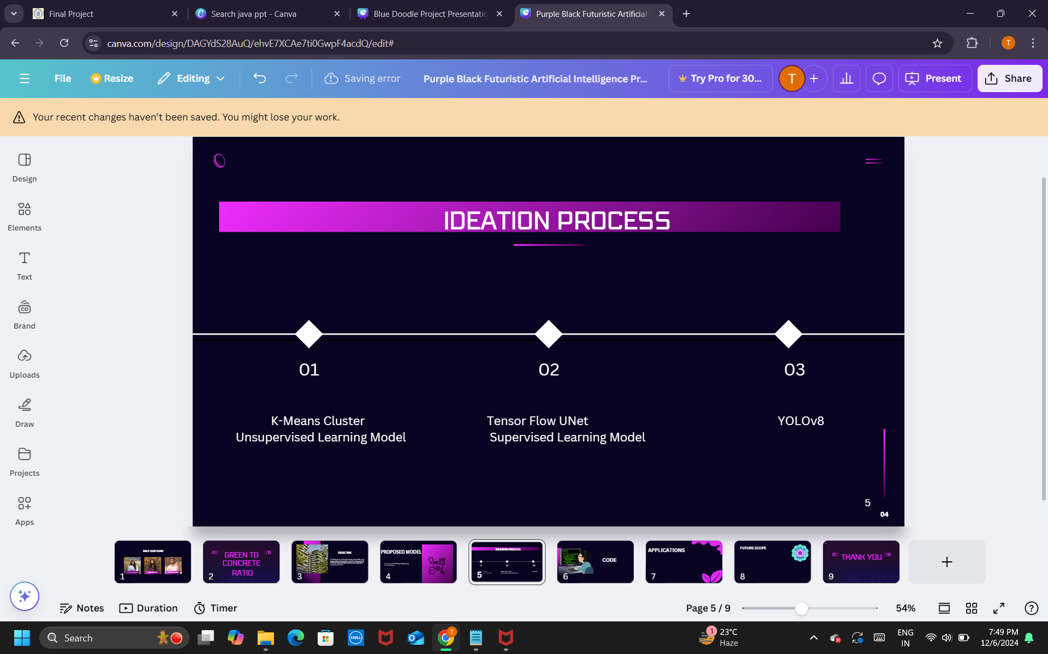

K-Means Cluster - Unsupervised Learning Model
Tensor Flow UNet - Supervised Learning Model
04

Slide 6
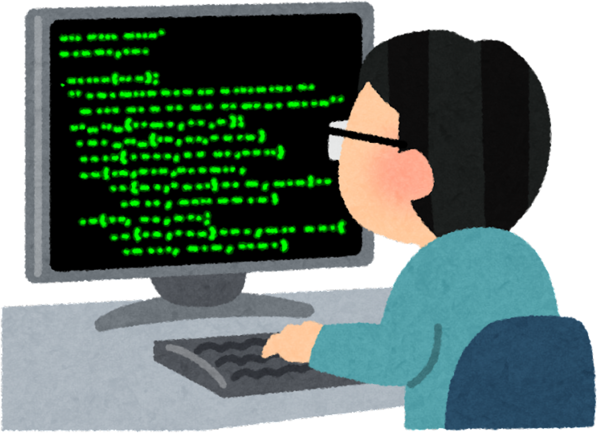
CODE
05

Slide 7


APPLICATIONS
Urban Planners
Government
Civil Engineers
06

Slide 8


FUTURE SCOPE
Working on the shades and Blur images
Dividing Water Resources
Differentiating Green to Concrete Ratio in Span of Time
07

Slide 9
THANK YOU
10

